Slide 1
EmpowHer
EmpowHER: Empowering Girls for Corporate Excellence Java Curriculum

Slide 2
Agenda Week 1
Java Essentials
Design Principles
Tip: Use infographics,
Smart Art,
Images/Screens,
Embed relevant learning videos/case study

Slide 3
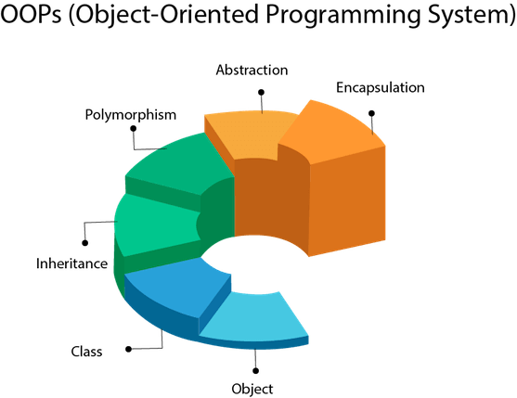
Topic 1 : Java Essentials
OOPS – Object Oriented Programming Language
An Object can be defined as an instance of a class. An object contains an address and takes up some space in memory. Objects can communicate without knowing the details of each other's data or code.
Example: A dog is an object because it has states like color, name, breed, etc. as well as behaviors like wagging the tail, barking, eating, etc.

Slide 4
Topic 1 : Java Essentials
Class
Collection of objects is called class. It is a logical entity.
A class can also be defined as a blueprint from which you can create an individual object.
Inheritance
When one object acquires all the properties and behaviors of a parent object, it is known as inheritance. It provides code reusability. It is used to achieve runtime polymorphism.

Slide 5
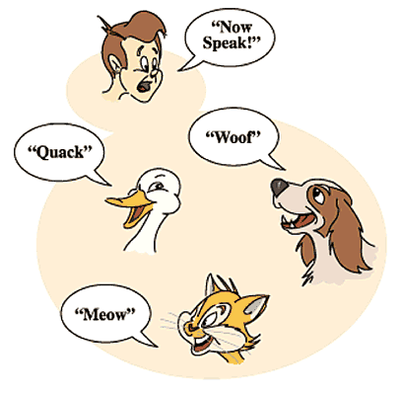
Topic 1 : Java Essentials
Can someone guess what is this concept?
<<Polymorphism>>
Same behavior in different forms.

Slide 6
Topic 1 : Java Essentials
Abstraction
Hiding internal details and showing functionality is known as abstraction.
Examples
TV monitor(Color tube) – shows different videos and images in different colors but internally it has some mechanism to do the work.
Any vehicle : Takes us from one place to other but hides internally how engine works and what its does internally.
Id card : when scanned if person has access door opens , internally hides how it match and finds out person access.
Pressure Cooker : When we keep for making rice , we put rice grains and water.. During the next 20-30 mins something happens internally and after few whistles we switch off and see that rice is ready for eating.
From students 1,2,3,4.

Slide 7
Topic 1 : Java Essentials
Encapsulation
Binding (or wrapping) code and data together into a single unit are known as encapsulation.
Java Class
Public Class Employee {
String empName;
Int empId;
Void getEmpName(empId)
{
return empName;
}
}
Public class SomeClass{
Employee e = new Employee();
e.getEmpName(123);
}

Slide 8
Topic 1 : Java Essentials
Java Data Types
Data types are divided into two groups:
Primitive data types - includes byte, short, int, long, float, double, boolean and char
int myNum = 5; // Integer (whole number) float myFloatNum = 5.99f; // Floating point number char myLetter = 'D'; // Character boolean myBool = true; // Boolean
Non-primitive data types - such as String, Arrays and Classes
String myText = "Hello"; // String

Slide 9
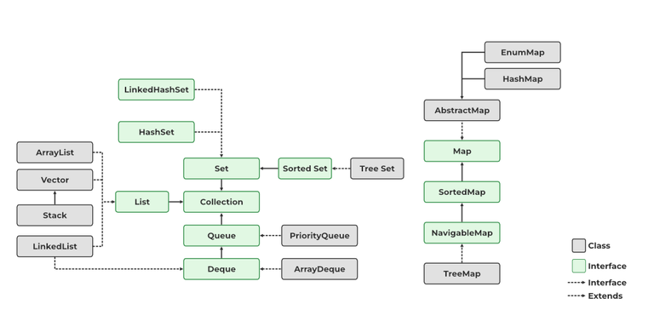
Topic 1 : Java Essentials: Java Collections

Slide 10
Topic 1 : Java Essentials : Exception Handling
What is exceptional Handling?
statement 1;
statement 2;
statement 3;
statement 4;
statement 5;//exception occurs
statement 6;
statement 7;
statement 8;
statement 9;
statement 10;
What happens to statements after statement 5?
Does not execute , b. executes till statement 10.

Slide 11
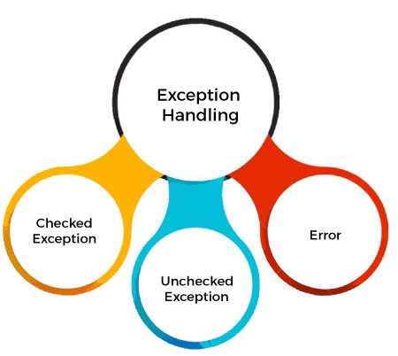
Topic 1 : Java Essentials : Exception Handling

Slide 12
Exception Handling Keywords
Keyword | Description
try | The "try" keyword is used to specify a block where we should place an exception code. It means we can't use try block alone. The try block must be followed by either catch or finally.
catch | The "catch" block is used to handle the exception. It must be preceded by try block which means we can't use catch block alone. It can be followed by finally block later.
finally | The "finally" block is used to execute the necessary code of the program. It is executed whether an exception is handled or not.
throw | The "throw" keyword is used to throw an exception.
throws | The "throws" keyword is used to declare exceptions. It specifies that there may occur an exception in the method. It doesn't throw an exception. It is always used with method signature.

Slide 13
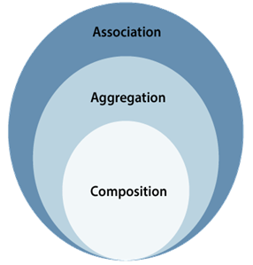
Topic 2 : Java Design Principles

Slide 14

Association
If two classes in a model need to communicate with each other, there must be a link between them, and that can be represented by an association (connector).

Slide 15
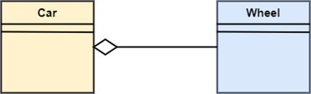
Aggregation
It represents has a relationship.

Slide 16
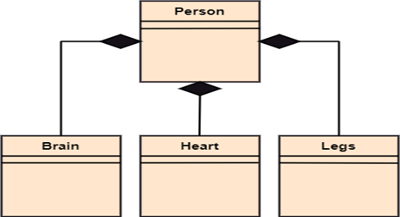
Composition
The composition is a part of aggregation, and it portrays the whole-part relationship. It depicts dependency between a composite (parent) and its parts (children)

Slide 17
JAVA SOLID PRINCIPLES
Principle | Description
Single Responsibility Principle | Each class should be responsible for a single part or functionality of the system.
Open-Closed Principle | Software components should be open for extension, but not for modification.
Liskov Substitution Principle | Objects of a superclass should be replaceable with objects of its subclasses without breaking the system.
Interface Segregation Principle | No client should be forced to depend on methods that it does not use.
Dependency Inversion Principle | High-level modules should not depend on low-level modules, both should depend on abstractions.

Slide 18
JAVA Design Patterns
A design patterns are well-proved solution for solving the specific problem/task.
Creational Design Pattern
Structural Design Pattern
Behavioral Design Pattern

Slide 19
Java Design Pattern : Singleton Pattern
Singleton is a creational design pattern that ensures a class has only one instance while providing a global access point to this instance. It's called 'singleton' because it restricts instantiation of a class to a single instance.
public class Singleton {
private static Singleton uniqueInstance;
private Singleton() {}
public static synchronized Singleton getInstance() {
if (uniqueInstance == null) {
uniqueInstance = new Singleton();
}
return uniqueInstance;
}
}

Slide 20
Agenda Week 2
Web Application
Its Layers
REST Web services and unit testing
POSTMAN how to use?
Spring Boot Essentials

Slide 21
Topic 1 : Web Application and its evolution
Web applications, commonly referred to as web apps, are computer programs that use web browsers and web technology to perform tasks over the Internet. They run on a web server and can be accessed through a web browser on any device connected to the internet.
Static Web Pages (Early 1990s) : HTMLs and no interaction with user or server.
Dynamic Web Pages (Mid-1990s): CGI , dynamic content creation and database interactions.
Web 2.0 (Early 2000s): Interactive web applications, enabling features like real-time updates and rich user interfaces.
Single Page Applications (Late 2000s): JavaScript frameworks like AngularJS and ReactJS, web applications started to mimic the behaviour of desktop applications.
Progressive Web Apps (Mid-2010s): These are web applications that can be installed on a user's device and run offline.
Serverless and Microservices (Late 2010s - Present): The latest trend in web application development is the move towards serverless architectures and microservices. This allows for greater scalability and flexibility, as each part of the application can be developed and deployed independently.

Slide 22
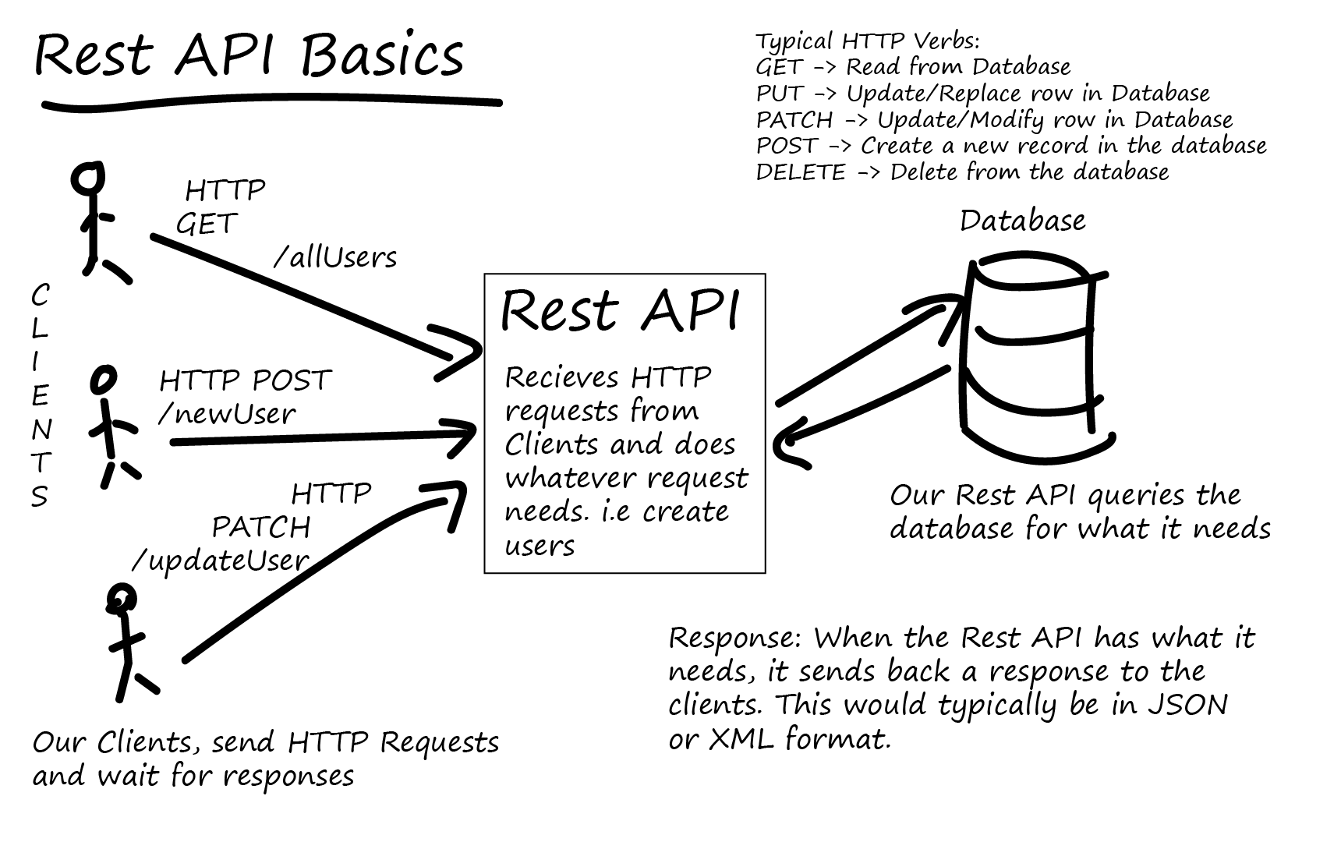
Topic 2 : REST Web Services

Slide 23
Topic 2 continued: Unit Testing
Unit Testing is a level of software testing where individual parts (or units) of a software are tested. A unit is the smallest testable part of any software, often a function or method within a class.
Testing RESTful APIs/endpoints/URLs : Tools like Postman and Rest-Assured.
Junits : developer side testing for each units/methods.

Slide 24
Topic 3:Importance of Spring boot essentials - component scan , bean scope
Spring Boot is a powerful framework used to simplify the bootstrapping and development of new Spring applications. Two essential features of Spring Boot are Component Scanning and Bean Scope.
Component Scan: This is a mechanism provided by Spring Framework where it automatically scans the specified package in your application and registers the classes annotated with @Component, @Controller, @Service, @Repository, etc. This feature is very handy as it saves the developer from manually defining and wiring beans in the application context. It simplifies auto-wiring of beans by matching by type, by name, or by qualifiers. It's important to properly structure your packages since Spring Boot, by default, scans sub-packages of the class that declares the @SpringBootApplication annotation.
Bean Scope: In Spring, every bean has a scope that defines its lifecycle and when a new instance should be created. The scopes provided by Spring are:
Singleton (default): Only one instance of the bean is created and shared for the entire application context.
Prototype: A new instance is created every time the bean is requested.
Request: A new bean is created for each HTTP request.
Session: A new bean is created for each HTTP session.
Application: A single bean is created for the lifetime of the ServletContext.
Websocket: A new bean is created for the lifecycle of a WebSocket.

Slide 25
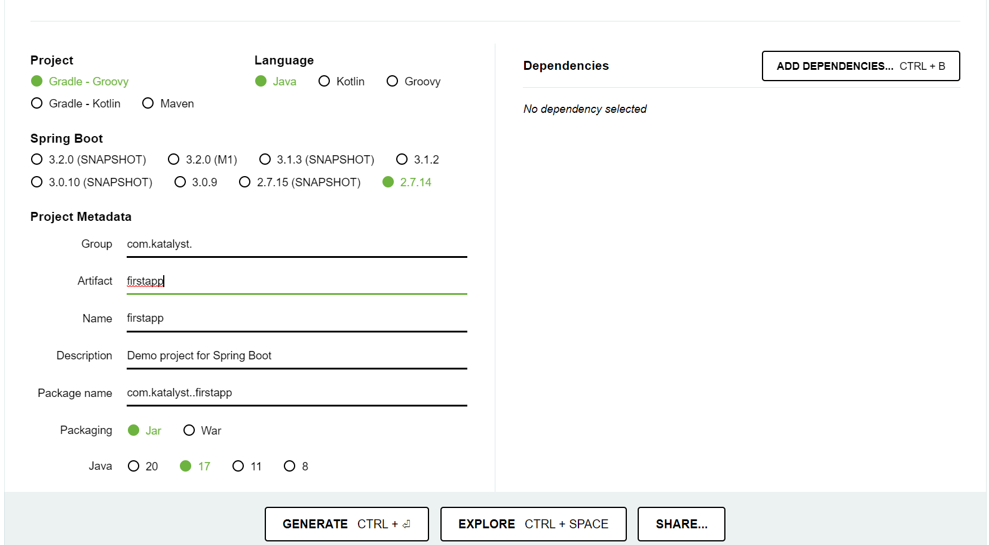
Topic 2: Introduction to Spring Boot Micro Services app – Spring boot initializer
Create first sprint boot Build and run first app.
https://start.spring.io/

Slide 26
Agenda Week 3
Dependency Injections :
Spring JDBC(Database relationship in spring : 1:1,1:m,m:m)
creation of tables and utility of these tables using H2 Database.
Spring Data JPA

Slide 27
Spring JDBC
Creating a JDBC Starter Project
Setting up the H2 Database
CRUD operations using Spring JDBCTemplate
Implement RowMapper to map table columns to bean property.
Setting up the H2 Database

Slide 28
Spring Data JPA
Java Persistence API (JPA) is designed to ease writing and maintaining sql queries.
@Entity , @Table ,@Id , @Column annotations.
Creating a Repository using @Repository annotation.
CRUD Operations using EntityManager and methods like find and merge which create SQL behind scenes and reduce the code that implementor has to write.
Can use @NamedQuery and @Query to customize any query that implementor wants to write.
To reduce this duplication , we will use Spring Data JPA which gives an interface called JPArepository.
Create an interface which extends this JPARepository. Create own classes which provide implementation of these interfaces and use inbuilt methods.

Slide 29
Agenda Week 4
Spring Web(Spring REST - REST methods/Action that we perform on objects. How to choose end-point. When to use PUT and When to use Patch), resource, rest endpoint. ( architecture which is of type MVC, 4 layered ).
Spring Test ( Controller Test case)
Lombok
spring AOP (logging and exceptional handling)
High Level on below :
Spring Batch
Spring Kafka(Just introduce names and tell what are used for) - Site couple of examples where these are used.

Slide 30
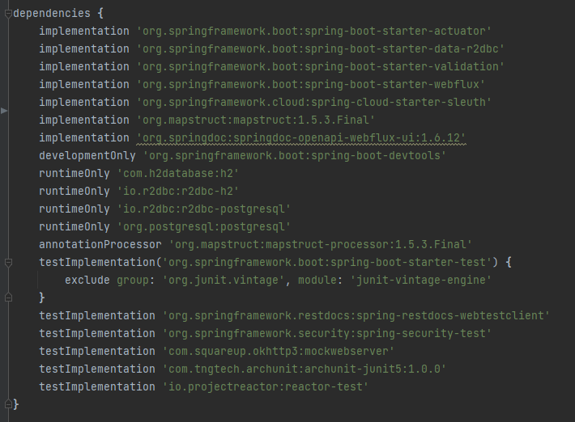
Code Snippet for Dependency Injection of topics of this class.

Slide 31
Topic 1: Spring Boot + REST API : GET
RequestMapping Annotation:
1. Used to map HTTP requests to handler methods of MVC and REST controllers
For Eg:
@RequestMapping("/courseMall")
GET method:
1. Used to retrieve data from the server.
2. A read-only method, so it has no risk of mutating or corrupting the data.
For Eg:
@GetMapping(path = "/candidates")
@GetMapping(path = "/candidate/{candidateId}")
@GetMapping(path = "/courses")
@GetMapping(path = "/course/{courseId}")

Slide 32
Topic 1: Spring Boot + REST API : POST and PUT
POST method:
1. Sends data to the server and creates a new resource.
2. Used to create a new data entry.
For Eg:
@PostMapping(path = "/newCandidate")
@PostMapping(path = "/newCourse")
PUT method:
1. Used to update but by replacing an existing resource.
For Eg:
@PutMapping(path = "/{candidateId}/candidate")
@PutMapping(path = "/{courseId}/course")

Slide 33
Topic 1: Spring Boot + REST API : DELETE
DELETE method is:
1. Used to delete a resource specified by its URI.
For Eg:
@DeleteMapping(path = "/{candidateId}/candidate")
@DeleteMapping(path = "/{courseId}/course")
Below two Tables has been used with REST API:
1. candidate
2. course

Slide 34
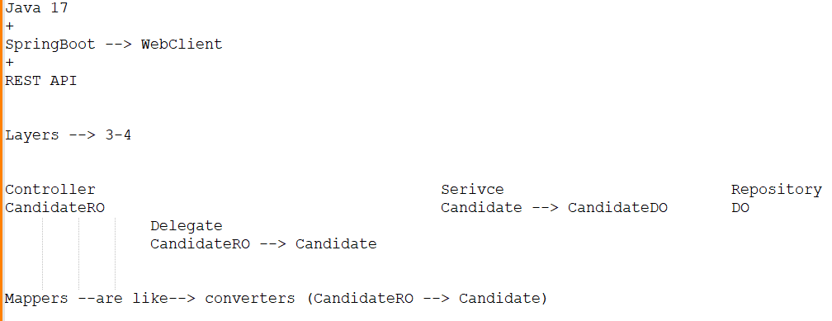
Topic 2: Layered Architecture
3 and 4 Layered Architecture:

Slide 35
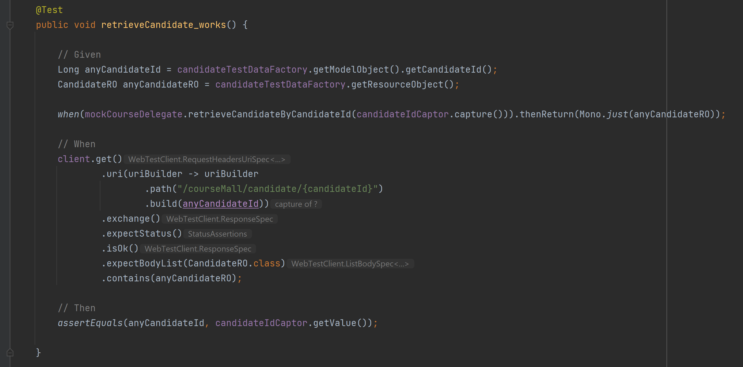
Topic 3: Spring Test ( Controller Test case)

Slide 36
Topic 4: Lombok
Project Lombok is a Java library tool that:
1. Generates code for minimizing boilerplate code.
2. Replaces boilerplate code with easy-to-use annotations.
For Eg:
By adding a couple of annotations, we get rid of code clutters, such as getters and setters methods, constructors, hashcode, equals, and toString methods, and so on.
Few Lombok constructs are:
@Getter, @Setter
@NoArgsConstructor, @AllArgsConstructor
@Data
@NotNull

Slide 37
Topic 5: Global Exception Handling with @ControllerAdvice
Spring AOP enables a mechanism to handle exceptions globally via:
@ControllerAdvice
@ExceptionHandler

Slide 38
Topic 6: Spring Batch
A lightweight, comprehensive batch framework designed to enable the development of robust batch applications vital for the daily operations of enterprise systems.
Spring Batch provides reusable functions that are essential in processing large volumes of records, including logging/tracing, transaction management, job processing statistics, job restart, skip, and resource management.
It also provides more advanced technical services and features that will enable extremely high-volume and high performance batch jobs through optimization and partitioning techniques. Simple as well as complex, high-volume batch jobs can leverage the framework in a highly scalable manner to process significant volumes of information.

Slide 39
Topic 7: Spring for Apache Kafka
The Spring for Apache Kafka (spring-kafka) project applies core Spring concepts to the development of Kafka-based messaging solutions.
It provides a "template" as a high-level abstraction for sending messages. It also provides support for Message-driven POJOs with @KafkaListener annotations and a "listener container". These libraries promote the use of dependency injection and declarative.
In all of these cases, you will see similarities to the JMS support in the Spring Framework and RabbitMQ support in Spring AMQP.

Slide 40
Agenda Week 5
Debugging
When is it required to debug?
How to put a debug point?
What is output before debug line?
How to disable breakpoint and run through?
Introduction to JUnits

Slide 41
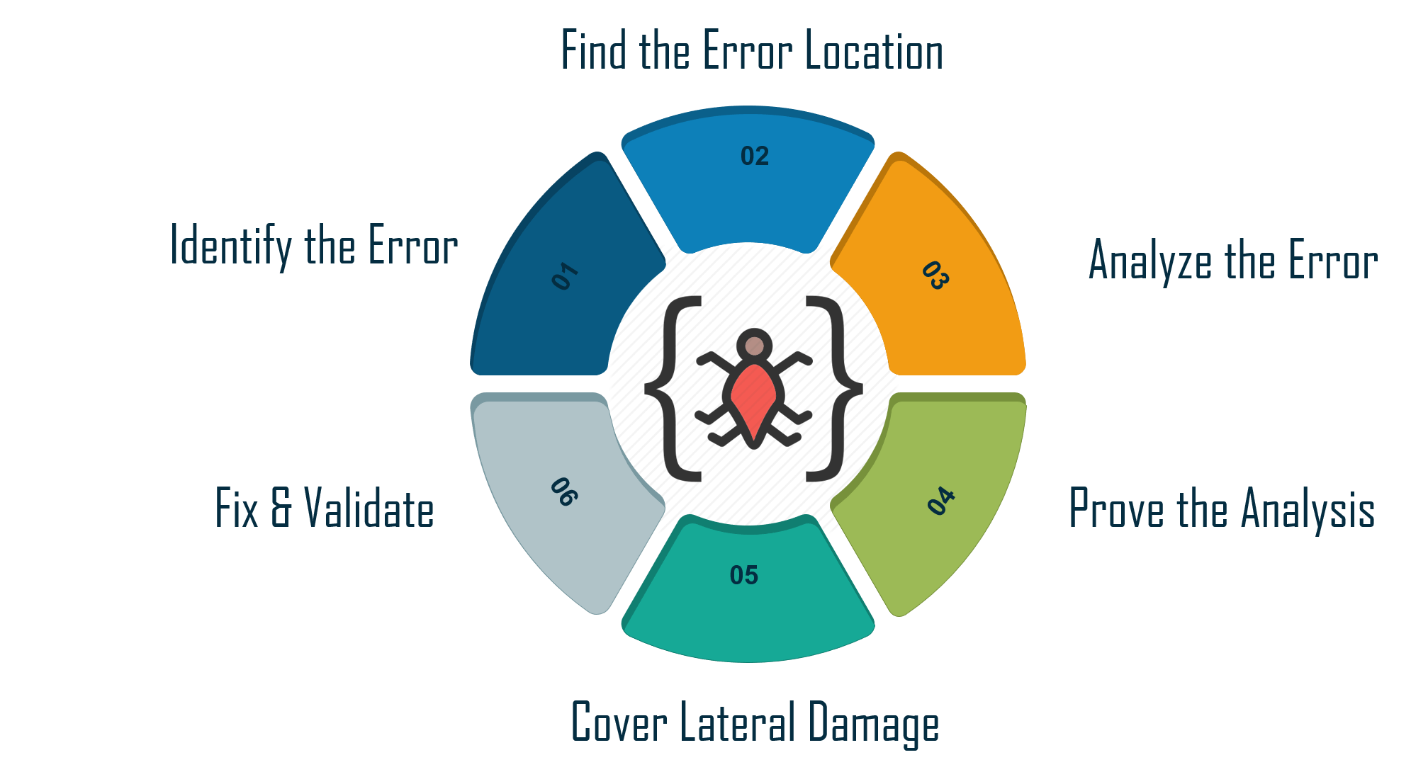
Topic 1 : What is Debugging

Slide 42
Topic 2 : Junits
JUnit framework provides annotations to identify test methods and gives assertions for testing expected results.
import org.junit.Test;
import static org.junit.Assert.assertEquals;
public class TestJunit {
@Test
public void testAdd() {
String str = "Junit is working fine";
assertEquals("Junit is working fine",str);
}
}

Slide 43
Agenda Week 6
What is application integration?
What is most important to integrate? With example...

Slide 44
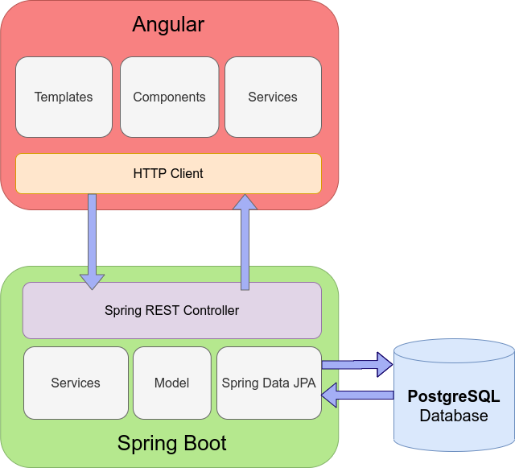
Topic 1 : Application Integration

Slide 45
Agenda Week 7
Work on case study

Slide 46
Agenda Week 8
Work on case study

Slide 47
Agenda Week 9
Work on case study

Slide 48
Agenda Week 10
DEMO and evaluation

Slide 49
Thank You!

Slide 50
Appendix
Add Links or permissible Images as needed

